Slide 1
Assignment 4.2 Charts
DSC640
Taniya Adhikari

Slide 2
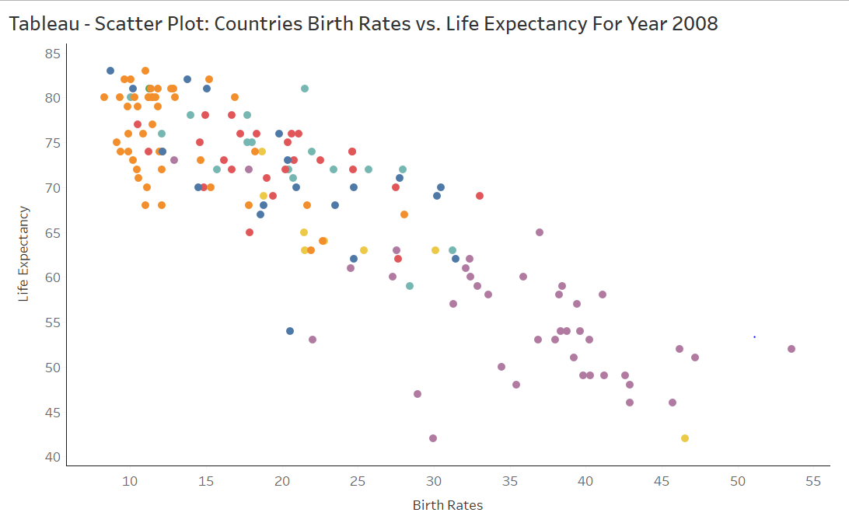
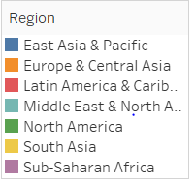
Tableau – Scatter Plot

Slide 3
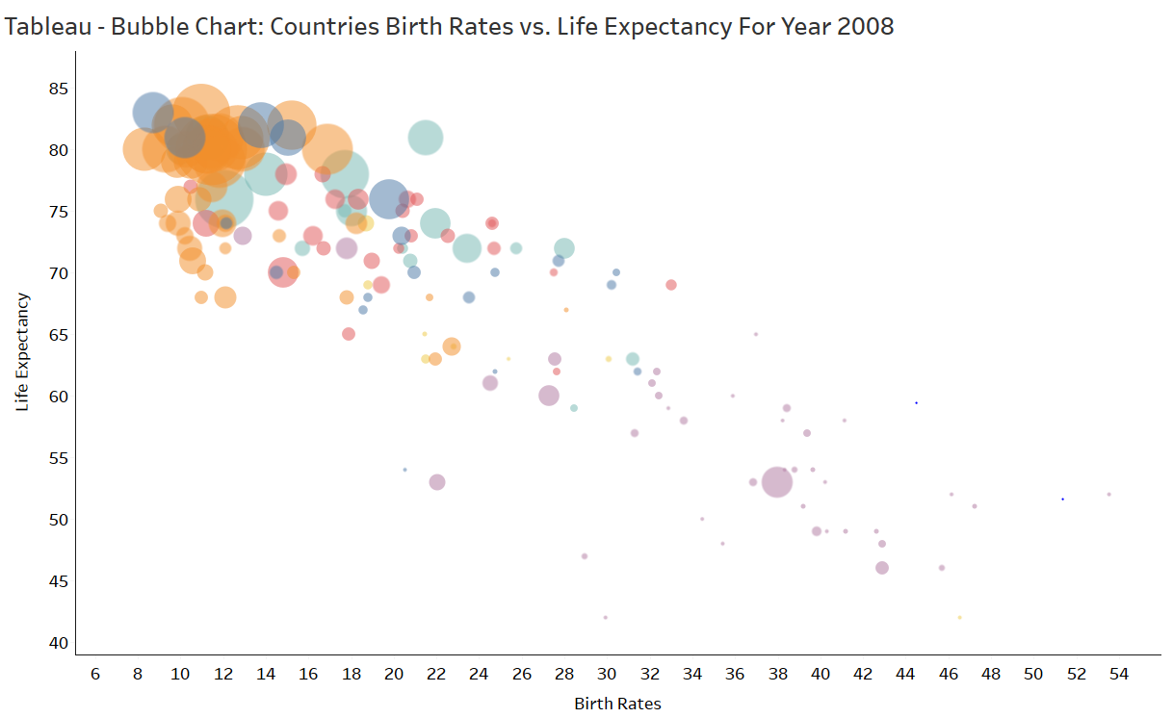
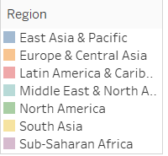
Tableau – Bubble Chart

Slide 4
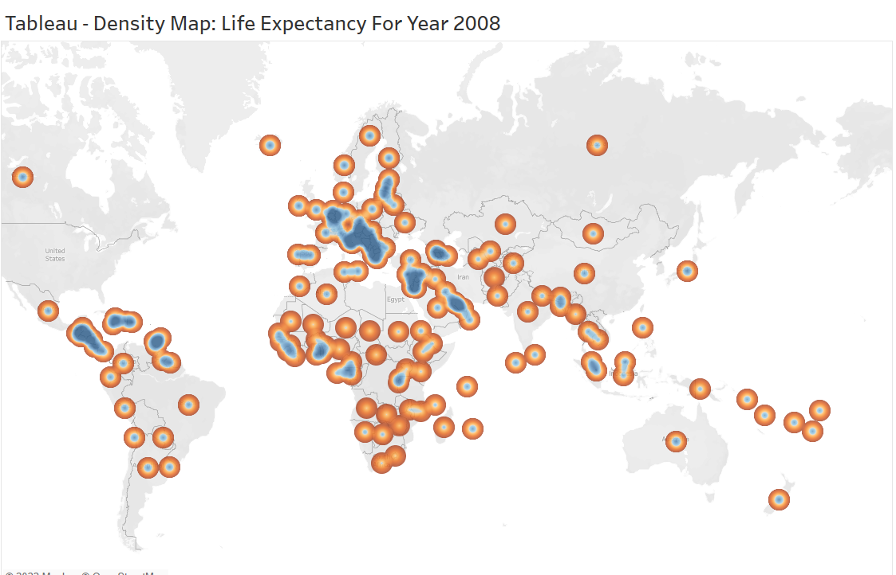
Tableau – Density Map

Slide 5
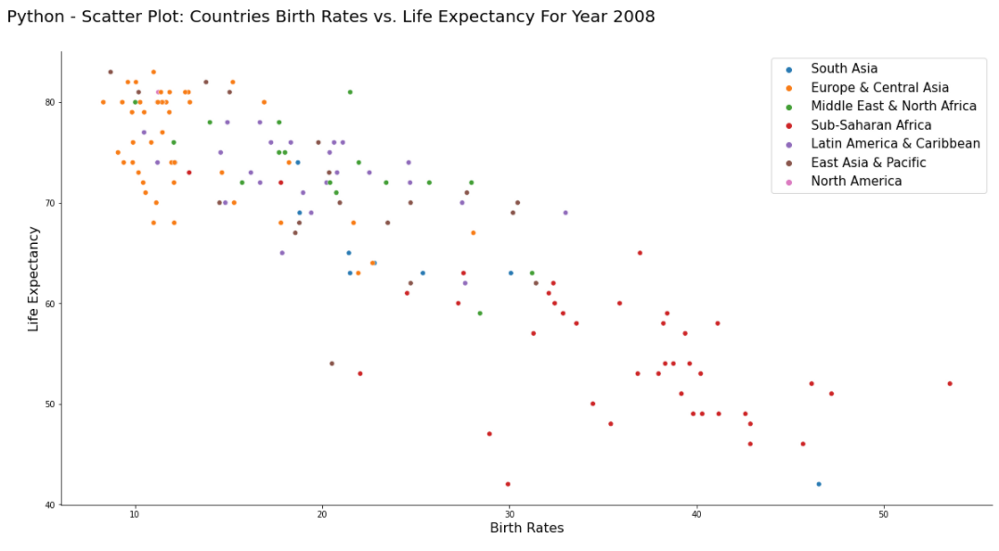
Python – Scatter Plot

Slide 6
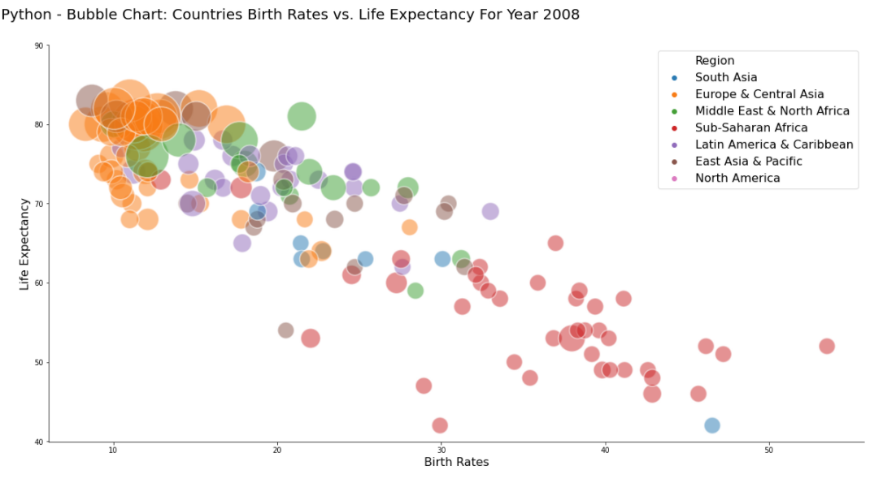
Python – Bubble Chart

Slide 7
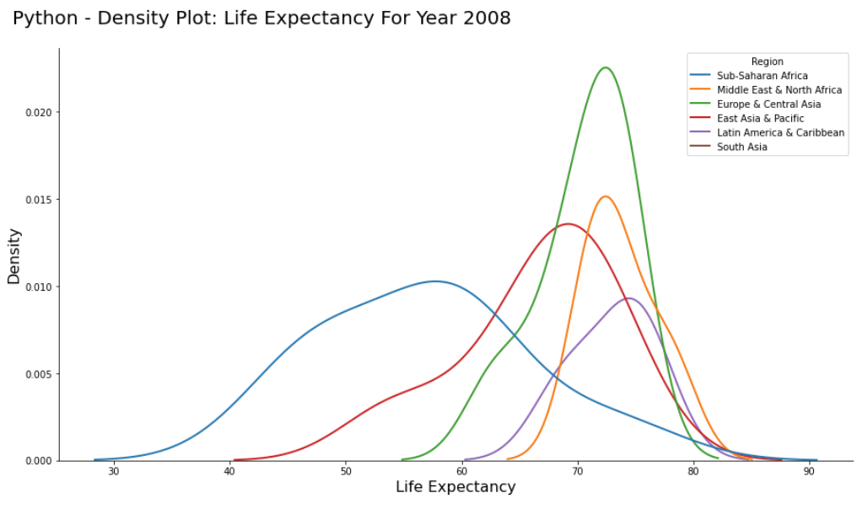
Python – Density Plot

Slide 8
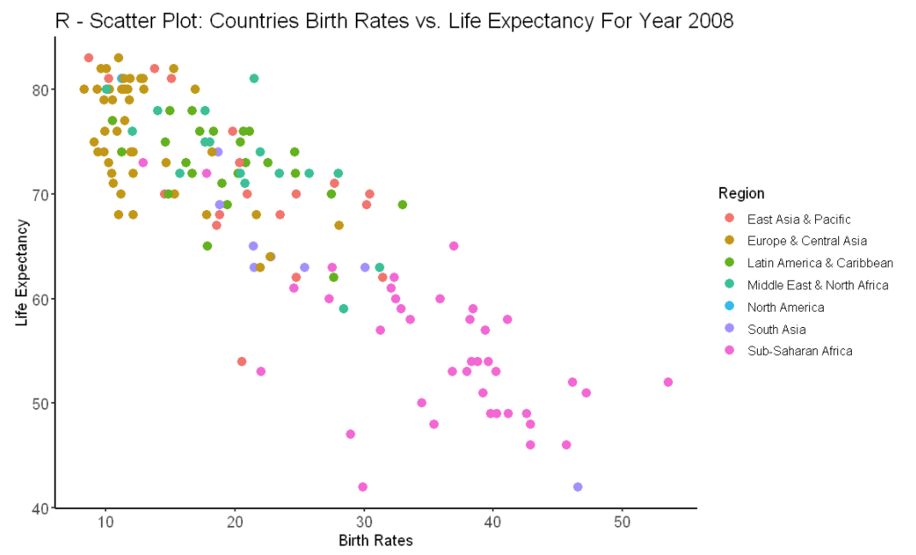
R– Scatter Plot

Slide 9
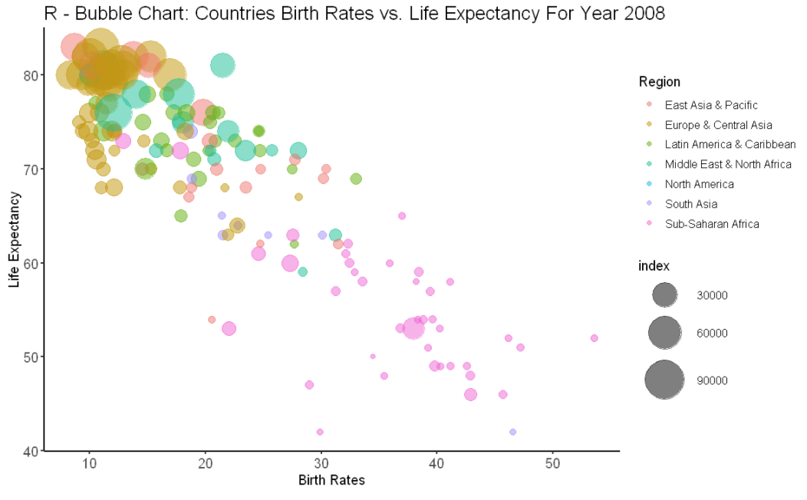
R – Bubble Chart

Slide 10
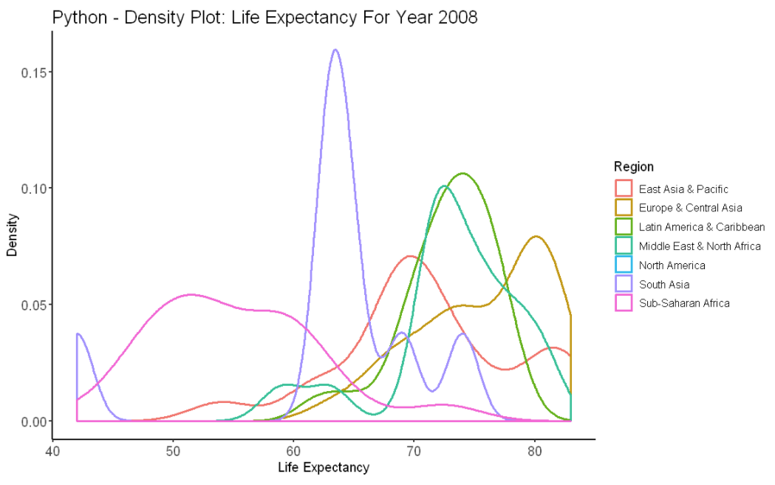
R – Density Plot

Slide 11
Supplemental Files
Tableau Screenshot
Python Code
R Code

Slide 12
